Slide 1

Smart Product Hunting for Facebook and Craigslist
Name: Ibtehaj Gulzar
Student ID: 30083149
September 2023/24

Slide 2
Introduction
Product hunting is time consumming and inefficient
The evolving role of digital platforms in e-commerce for product hunting.
Facebook and Craigslist as major players in online marketplaces and classifieds.
The challenges of finding relevant products on Facebook and Craigslist platforms (Srivastava, 2021).
The use of smart algorithms for personalized product recommendations on Facebook.
The need for robust product search systems to navigate Craigslist's minimal interface.
The importance of AI and data mining in enhancing product hunting efficiency (Bello et al., 2023).
Leveraging AI and data scraping technologies to enhance the search.
Develop smart systems that ensure secure, accurate, and personalized product searches.

Slide 3

Aims and Objectives
Main Goal: Develop a smart system that enhances product discovery by using AI for trend predictions and data scraping techniques.
Specific Objectives:
Efficiently identify high-demand products on Facebook and Craigslist.
Improve search accuracy and reduce search time for a normal user and e-commerce businesses.
Create a user-friendly interface that displays real-time product trends.

Slide 4
Proposed Solution
System Overview:
Scrapes product data from Facebook and Craigslist using Puppeteer.
Predicts product trends using AI models (Random Forest Classifier).
Provides users with personalized, real-time product recommendations.
Why AI?: AI helps predict the popularity of products based on user data and product history, making the search process more effective.

Slide 5

Methodology and Design
Front-End Framework: React JS for developing user interface and interaction forms.
Back-End Structure: Node.js with Express for API endpoints and managing user sessions.
Data Scraping Tool: Puppeteer for product data scraping from Craigslist and Facebook (Guven, 2020).

Slide 6
Methodology and Design
AI Model: Random Forest Classifier in Python for product trend prediction and analysis.
Database Management: MongoDB for storing and retrieving product data and user details (Bharadiya, 2023).
Integration: Flask for linking AI model predictions with the Node.js back-end.

Slide 7

Problems Encountered
Complex integration of multiple technologies (React, Node.js, Python) for smooth functionality.
Handling API requests and session authentication in the backend was challenging.
Maintaining high accuracy while scraping data from Facebook and Craigslist using Puppeteer.
Ensuring compliance with data access policies of third-party websites during scraping.
Real-time AI trend prediction accuracy and performance required fine-tuning of data (Esenogho, Djouani and Kurien, 2022).
Balancing user-friendly design with powerful AI-based features in the front-end interface (Mahoto et al., 2021)

Slide 8
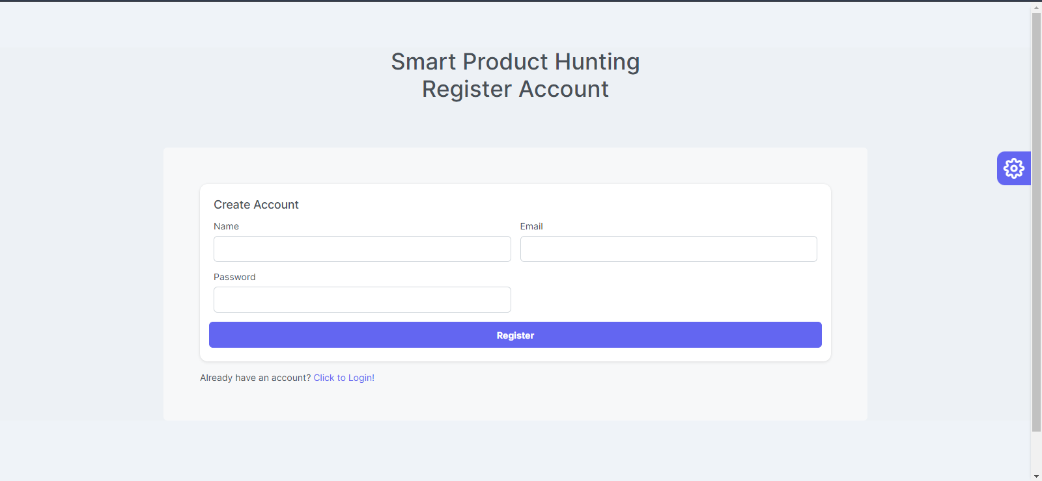
Initial Results and tesing
User registration and login processes work smoothly, ensuring proper authentication.
Product scraping from Facebook and Craigslist using Puppeteer is highly efficient.
Model predicts product trends using historical data with good accuracy (Srivastava, 2021).

Slide 9
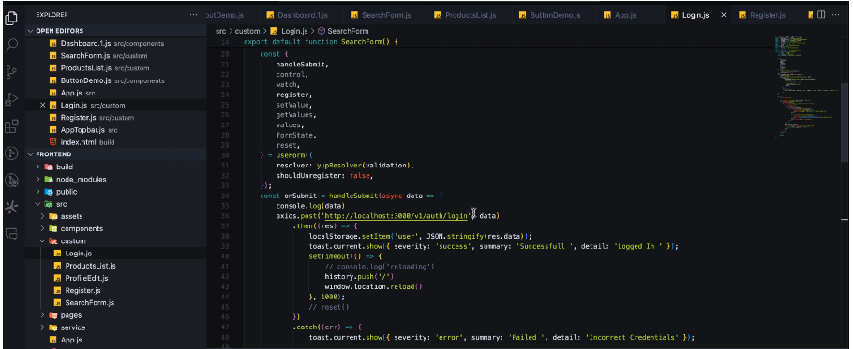
Initial Results and tesing
Product listing displays scraped data in an organized and user-friendly table.
Real-time trend forecasting integrates seamlessly with the frontend and backend (Esenogho, Djouani and Kurien, 2022).

Slide 10
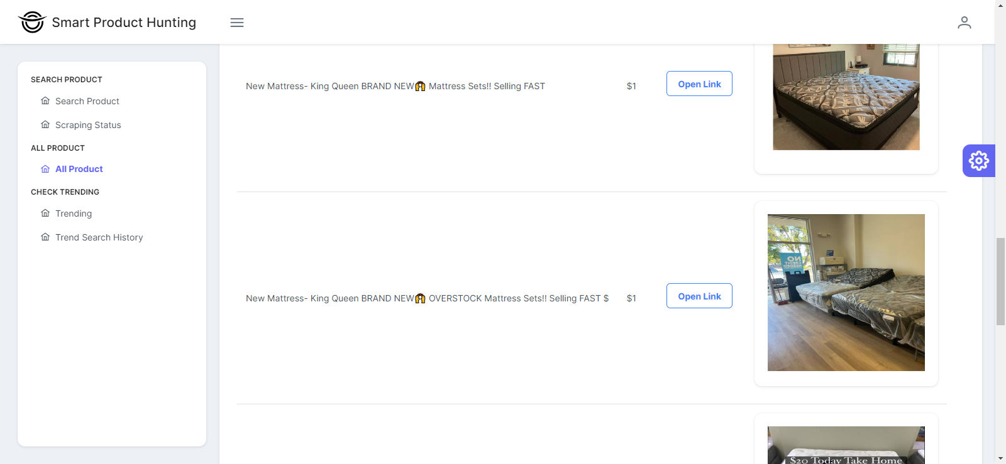
Results
User Authentication: Successful registration and login functionalities were implemented and tested.
Data Scraping: Efficient scraping of product data from Facebook and Craigslist using Puppeteer.
Product Listing: Scraped data was effectively displayed and managed in a structured format..
Real-Time Response: Flask server enabled instant prediction results.
User Interface: React-based interface was responsive and user-friendly, enhancing overall navigation (Jain, Sharma and Kishor, 2021).

Slide 11

Conclusion
The developed system improves efficient product searches on Facebook and Craigslist and more personalized for users
The use of AI for trend prediction enhances the decision-making process for users looking for trending products.
Strategic search methods ensure better user satisfaction by offering relevant product recommendations.
This project demonstrates the power of combining data scraping and AI for solving real-world problems in e-commerce
User trust and security are vital when conducting product searches on online platforms.

Slide 12

Future Work
Expand the dataset to include more diverse user behaviors and preferences.
Expand the system to include more platforms like eBay and Amazon.
Enhance search efficiency by optimizing algorithms to handle large product databases (Esenogho, Djouani and Kurien, 2022).
Develop improved filtering tools for product categorization, enhancing user experience.
Incorporate user feedback mechanisms to refine product recommendations over time.
Experiment with more advanced AI models

Slide 13

References
Balaraman, P. and Chandrasekar, S., 2016. E-commerce trends and future analytics tools. Indian Journal of Science and Technology, 9(32), pp.1-9.
Srivastava, A., 2021. The Application & Impact of Artificial Intelligence (AI) on E-Commerce. Contemporary Issues in Commerce & Management, 1(1), pp.165-175.
Bello, O.A., Folorunso, A., Onwuchekwa, J., Ejiofor, O.E., Budale, F.Z. and Egwuonwu, M.N., 2023. Analysing the impact of advanced analytics on fraud detection: a machine learning perspective. European Journal of Computer Science and Information Technology, 11(6), pp.103-126.
Guven, H., 2020. Industry 4.0 and marketing 4.0: in perspective of digitalization and E-Commerce. In Agile Business Leadership Methods for Industry 4.0 (pp. 25-46). Emerald Publishing Limited.
Mahoto, N.A., Iftikhar, R., Shaikh, A., Asiri, Y., Alghamdi, A. and Rajab, K., 2021. An Intelligent Business Model for Product Price Prediction Using Machine Learning Approach. Intelligent Automation & Soft Computing, 30(1).
Bharadiya, J.P., 2023. Machine learning and AI in business intelligence: Trends and opportunities. International Journal of Computer (IJC), 48(1), pp.123-134.
Esenogho, E., Djouani, K. and Kurien, A.M., 2022. Integrating artificial intelligence Internet of Things and 5G for next-generation smartgrid: A survey of trends challenges and prospect. Ieee Access, 10, pp.4794-4831.
Jain, A., Sharma, Y. and Kishor, K., 2021, July. Prediction and analysis of financial trends using ml algorithm. In Proceedings of the International conference on innovative computing & communication (ICICC).

Slide 14
Project Links
Here are the GitHub and drive links of project resources. All these repositories are public, so anyone with the link can have access to these resources.
Back-end: https://github.com/IbtehajMughal/sph-backend.git
Front-end: https://github.com/IbtehajMughal/sph-frontend.git
This link also includes dissertation, presentation and demo video files of project.
Dataset files: https://drive.google.com/drive/folders/1ArF5PU6p9Lz8FzOUgy3xX7As87ZXOfVM?usp=sharing

